Slide 1
Red-Black Trees

Slide 2
A Tree
Why Trees? O(logN) operations
A tree is a collection of nodes:
The collection can be empty;
Otherwise consists of,
a distinguished node r, called the root
zero or more (sub)trees T₁, T₂, …, T_{k}, each of whose roots are connected by a directed edge from r.
The root of each subtree is said to be a child of r, and r is the parent of each subtree root.

Slide 3
Concepts on Trees
The root is the only node without parent.
Nodes with no children are known as leaves.
Nodes with the same parent are siblings.
A path from node n₁ to n_{k} is defined as a sequence of node n₁, n₂, …, n_{k} such that n_{i} is the parent of n_{i+1} for 1 ≤ i < k.
The length of the path is the number of edges on the path
There is a path of length zero from every node to itself.
In a tree there is exactly one path from the root to each node.

Slide 4
Binary Search Trees
Assumptions:
each node in the tree stores an item.
those items are integers.
all the items are distinct.
The properties:
For every node, X, in the tree, the values of all the items in its left subtree are smaller than the item in X, and the values of all the items in its right subtree are larger than the item in X.

Slide 5
Which one is a Binary Search Tree?
6
6
2
8
2
8
1
4
1
4
3
3
7

Slide 6
Operations on a Binary Search Tree
Contains( int x): Is x an element of BST
FindMax() find the maximum values
FindMin(): find the minimum value
Adding and deleting elements
Keep the tree balanced

Slide 7
Find Minimum Element
private BinaryNode<AnyType> findMin (BinaryNode<AnyType>)
{
if (t==null)
return null;
else
if (t.left==null)
return t;
return findMin(t.left);
}

Slide 8
Search for An Element
private boolean contains (AnyType x, BinaryNode<AnyType>) {
If(t==null) return false;
int compareresults=myCompare(x, t.element)
If( compareResult <0)
return contains(x,t.left)
Else if (compareResut >0)
return contains(x,t.right)
Else return true}

Slide 9
Insert An Element
private boolean contains (AnyType x, BinaryNode<AnyType>) {
If(t==null) return new BinaryNode;
int compareresults=myCompare(x, t.element)
If( compareResult <0)
t.left= insert(x,t.left)
Else if (compareResut >0)
t.right= insert(x,t.right)
Else Do nothing}

Slide 10
Delete
The node to be deleted has three conditions
The node is a leaf
The node has one child
The node has two children

Slide 11
How to Remove a Node?
What if the node is a leaf?
It can be deleted immediately.
51
51
39
39
20
45
45
49
49

Slide 12
How to Remove a Node?
What if the node has one child?
It can be deleted after its parent adjusts a pointer to bypass the node
51
51
39
39
20
45
30
45
30
49
25
31
49
25
31

Slide 13
What if the node has two children?
The general strategy is to replace the data of this node with the smallest data of the right subtree, and recursively delete the node.
Find smallest data in right tree
Replace this value in the node
Delete smallest data
6
6
2
8
3
8
1
5
1
5
3
4
4
How about using the left subtree

Slide 14
Balanced Trees
Best complexity for addition/deletion and search in binary trees is O(logn).
This is true only if the tree is balanced---nearly equal height on each side.
Different types of balanced trees proposed
AVL, B-Trees, Red-Black Trees

Slide 15
Red-Black Trees
A binary search tree where…
Every node is either red or black
The root is black
Every leaf (NIL) is black
If a node is red then both its children are black
For each node, all paths from the node to descendant leaves contain the same number of black nodes
Black height of a node is the number of black nodes from the node to the leaf. The node itself is not counted in the path

Slide 16
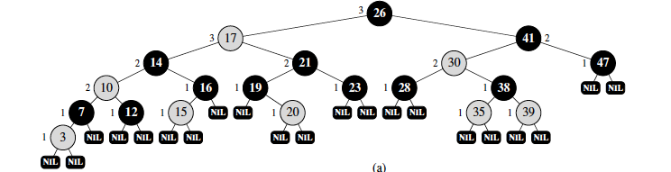
Example
Black nodes colored black
Red nodes colored red

Slide 17
Height of Red Black Tree
A R_B tree with n internal nodes has height at most 2(log n+1)
The subtree rooted at node x contains at least 2^{bh(x)}-1 internal nodes. Proof by Induction
Let the height of the tree be h
At least half the nodes from the root to leaf (not counting the root) are black
Thus the black height of the tree must be at least h/2

Slide 18
Height of Red-Black tree
N >=2 ^{h/2}-1
h<= 2lg(n+1)
Thus search, finding maximum, finding minimum can all be done in O(lgn)
Insertion and Deletion can also be run in O(lgn)

Slide 19
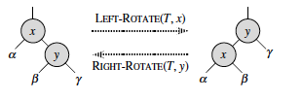
Rotation
Need to rotate newly inserted nodes to preserve red-black property

Slide 20
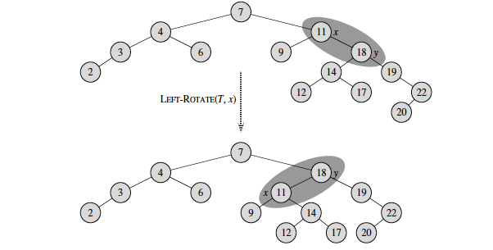
Rotation Example

Slide 21
Insertion
First find the position of the node in the R-B Tree
Color new node red
Adjust the tree to maintain R-B property

Slide 22
Tree Adjusting
z is the instance where a red node has a red parent
If parent is root then make parent black
Case 1: Parent and uncle of z also red
Make grandparent red
Make parent and uncle black
Case 2: Uncle is black
Color parent black
Color grandparent red
Do rotation
Complexity of Insertion is O(lgn)—why ?

Slide 23
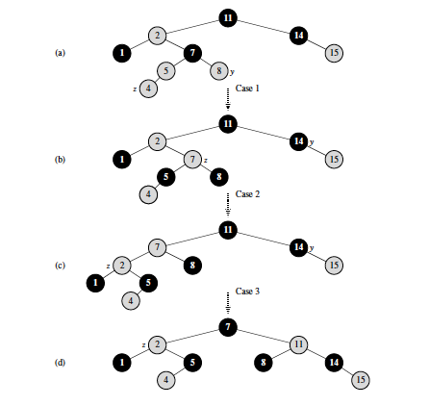

Slide 24
Deletion
Similar to deleting in binary search trees
Except---
Leaves are NIL nodes, so we do not delete at leaves, and adjust NIL nodes accordingly
If we delete a red node—no problem
If we delete a black node, then we will reduce the number of black nodes in a path. Have to fix it

Slide 25
Deletion—Double Black Node
Recall that you are deleting either a node with NILs or node with one child
The NIL node will be a double black
Has to stand for two blacks to keep black height same in all paths
Fix by adjusting the black nodes
39
39
39
39
20
45
35
45
20
45
NIL
45
NIL
35
NIL
NIL
NIL

Slide 26
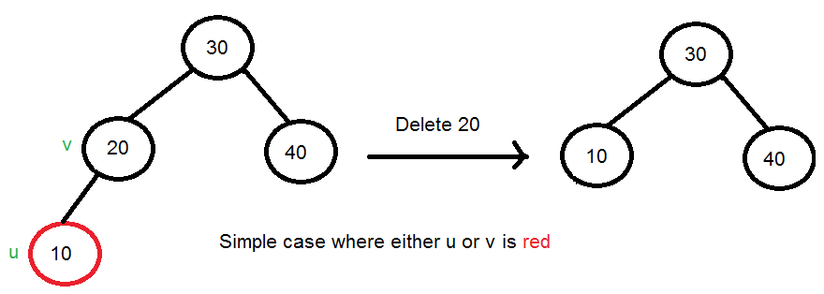
Case 1 Either child or parent is red
Images from :http://www.geeksforgeeks.org/red-black-tree-set-3-delete-2/

Slide 27
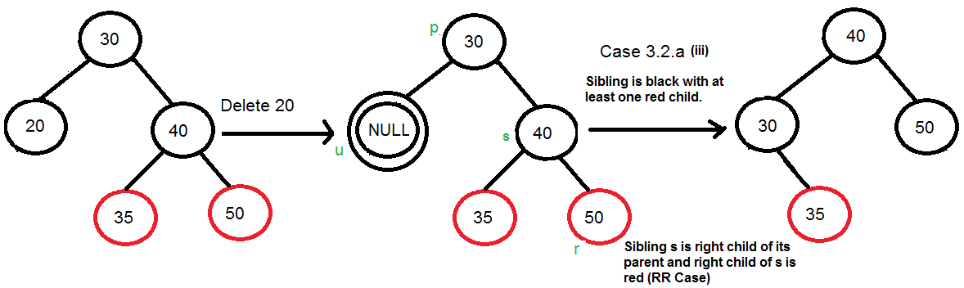
Case 2: Node and parent are black. Sibling of node is black . At least one child of sibling is red
Rotate sibling branch
Example with right child

Slide 28
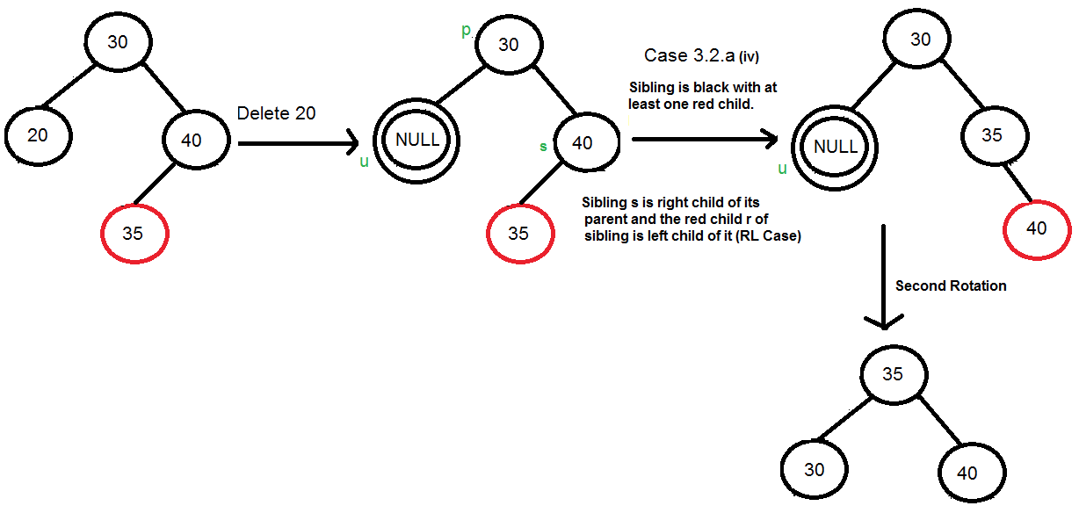
Case 2: Node and parent are black. Sibling of node is black . At least one child of sibling is red Rotate sibling branch
Example with left child

Slide 29
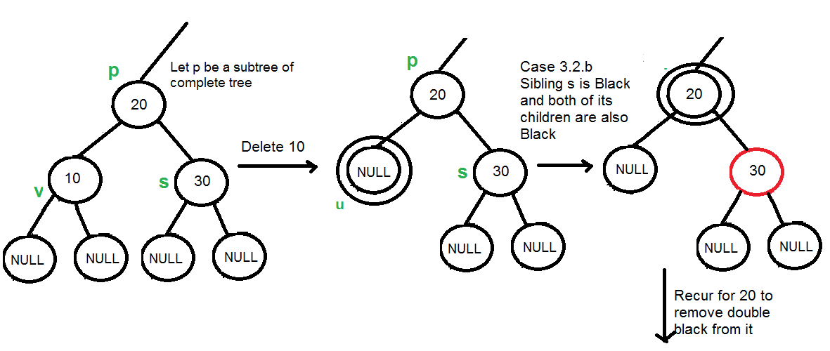
Case 3: Node and parent are black. Sibling of node is black . Both children are black. Move double black upto parent—and continue

Slide 30
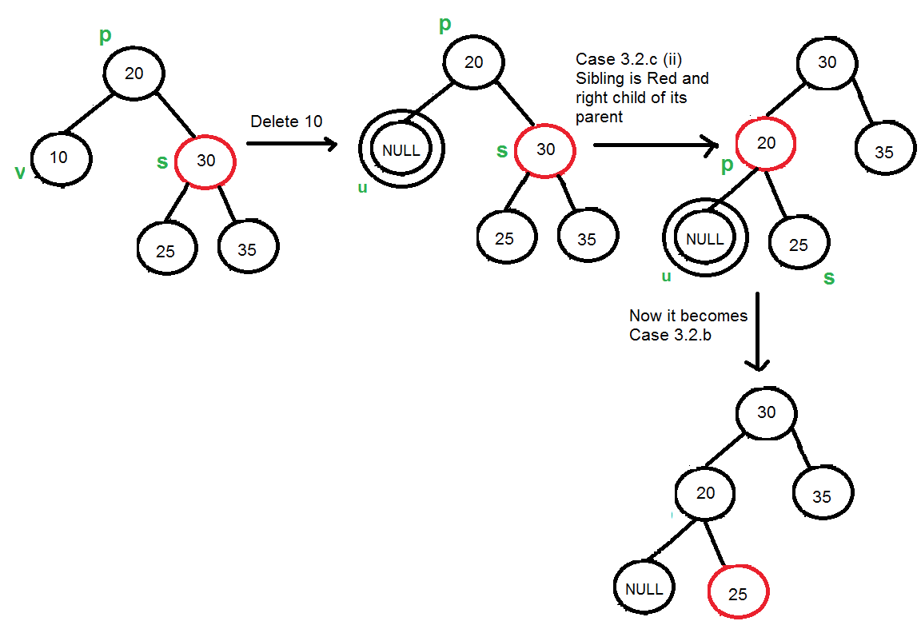
Case 4: Node and parent are black. Sibling of node is red. Rotate to move sibling up. Change color of sibling and parent.

Slide 31
Summary of Insertion and Deletion Rules
If problem at root-color root black
Insertion can cause change in black height, rotate tree to maintain black height after each insertion
Deletion will cause double black nodes
Find appropriate red node (parent / sibling/ child of sibling) to make it black

Slide 32
Exercise
10
10
30
9
30
9
NIL
NIL
NIL
NIL
20
20
38
38
NIL
NIL
NIL
NIL
NIL
NIL
NIL
NIL
Delete 9 in all the tree
Delete 10 in all the trees

